Slide 1
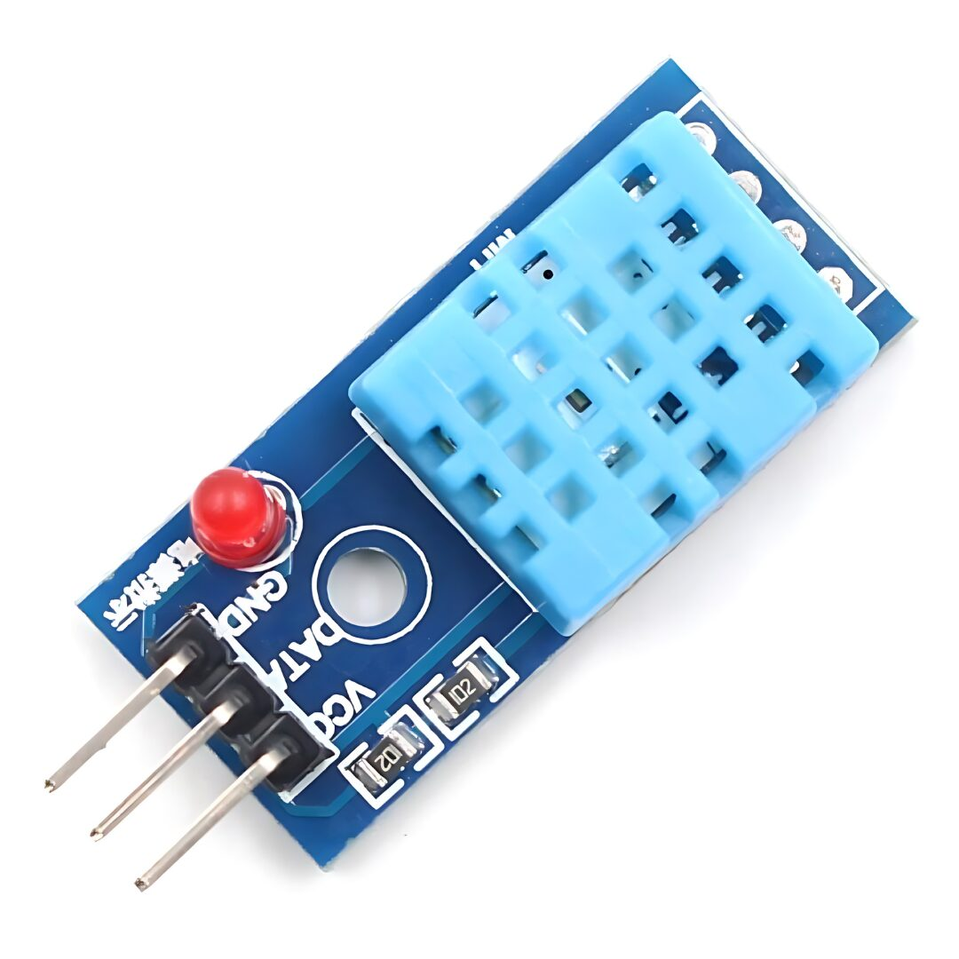
IOT AND CLOUD COMPUTING LAB
By,
Asst. Prof. S. Asra
M.E(Computer Science and Engineering)
B.E(Computer Science & Engineering)
Diploma(Computer Science & Engineering)

Slide 2
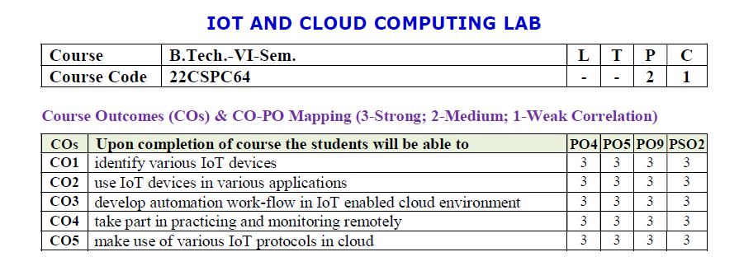

Slide 3
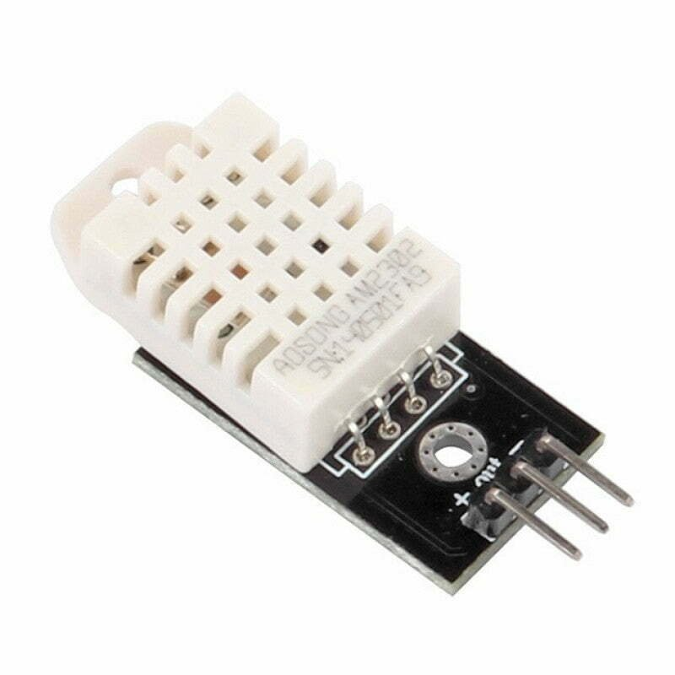
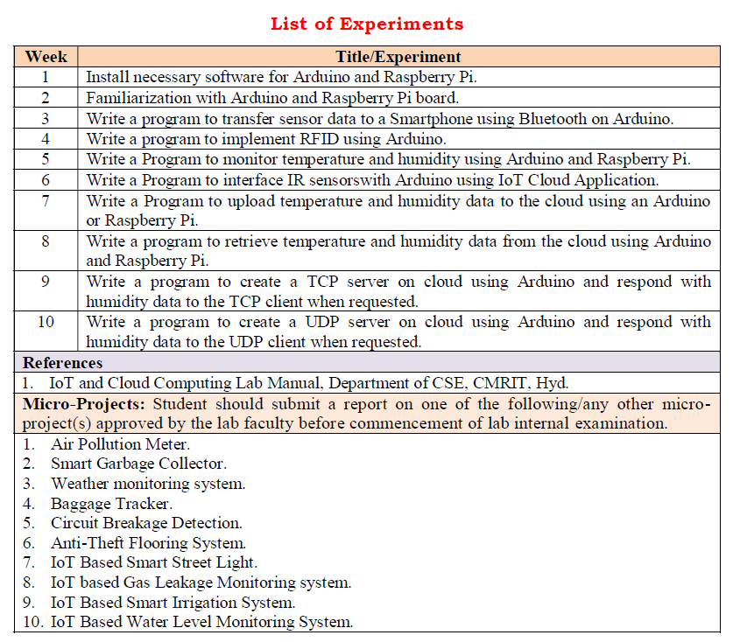

Slide 4
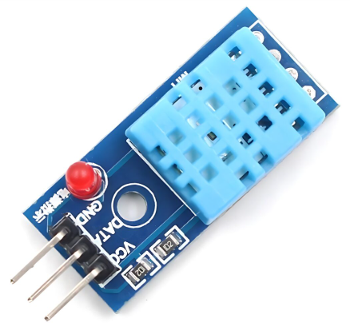
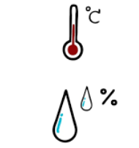
DHT22 Temperature and Humidity Sensor
DHT11 Temperature and Humidity Sensor
Asst. Prof. S.Asra
CSE Department, CMRIT

Slide 5
The DHT11 is a digital temperature and humidity sensor that provides calibrated output via a single-wire communication protocol.
It is commonly used in
weather monitoring systems,
home automation, and
IoT applications.
1. Weather Monitoring Systems
🌤️ Used in DIY and professional weather stations to measure temperature and humidity levels.
2. Home Automation & Smart Homes
🏡 Integrated into IoT-based smart home systems for automatic climate control, triggering fans, air purifiers, or dehumidifiers.
DHT11 Temperature and Humidity Sensor
Asst. Prof. S.Asra
CSE Department, CMRIT

Slide 6
3. Greenhouse Monitoring
🌱 Helps maintain optimal temperature and humidity levels for plant
growth in agricultural environments.
4. Industrial Environmental Monitoring
🏭 Used in factories and warehouses to monitor environmental
conditions that affect machinery and stored goods.
5. HVAC (Heating, Ventilation, and Air Conditioning) Systems
❄️ Helps in climate control systems by providing real-time temperature and humidity data for automated adjustments.
DHT11 Temperature and Humidity Sensor
Asst. Prof. S.Asra
CSE Department, CMRIT

Slide 7
Specifications:
Temperature Range: 0°C to 50°C (±2°C accuracy)
Humidity Range: 20% to 90% RH (±5% accuracy)
Operating Voltage: 3.3V - 5V
Output Signal: Digital (single-wire)
Sampling Rate: 1 Hz (one reading per second)
Response Time: ~2 seconds
Dimensions: 15mm x 12mm x 5mm
Pinout:
VCC - Power supply (3.3V or 5V)
Data - Digital output (connect to a pull-up resistor, typically 4.7kΩ)
GND - Ground
DHT11 Temperature and Humidity Sensor
Asst. Prof. S.Asra
CSE Department, CMRIT

Slide 8
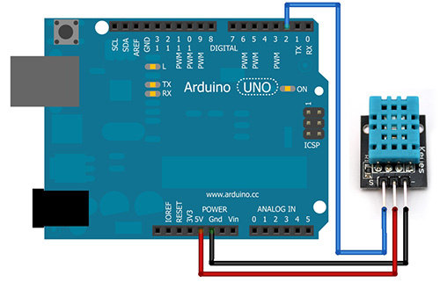
Asst. Prof. S.Asra
CSE Department, CMRIT

Slide 9
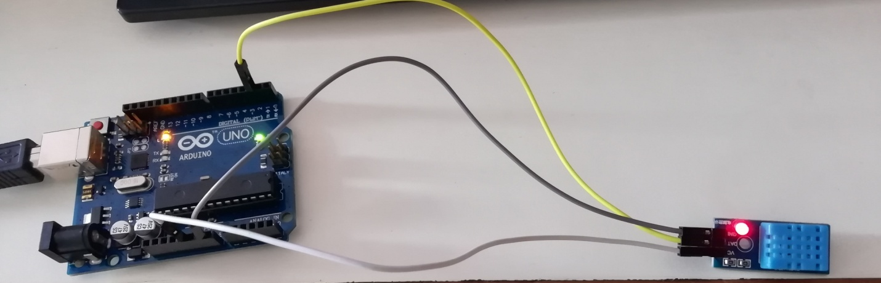
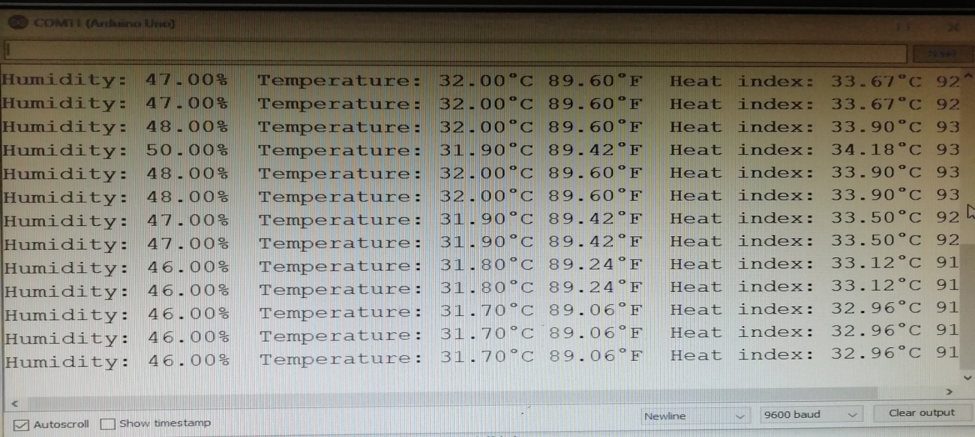
OUTPUT:
Asst. Prof. S.Asra
CSE Department, CMRIT

Slide 10
DHT22 Temprature and Humidity Sensor Module
Supply Voltage-5V
Temperature Range -40°C to 80°C
Temperature Resolution-0.1°C
Temperature Error-< ±0.5°C
Humidity Range 0% to 100% RH
Pinout:
VCC - Power supply (3.3V or 5V)
Data - Digital output (connect to a pull-up resistor, typically 4.7kΩ)
GND - Ground
DHT22 Temperature and Humidity Sensor
Asst. Prof. S.Asra
CSE Department, CMRIT

Slide 11
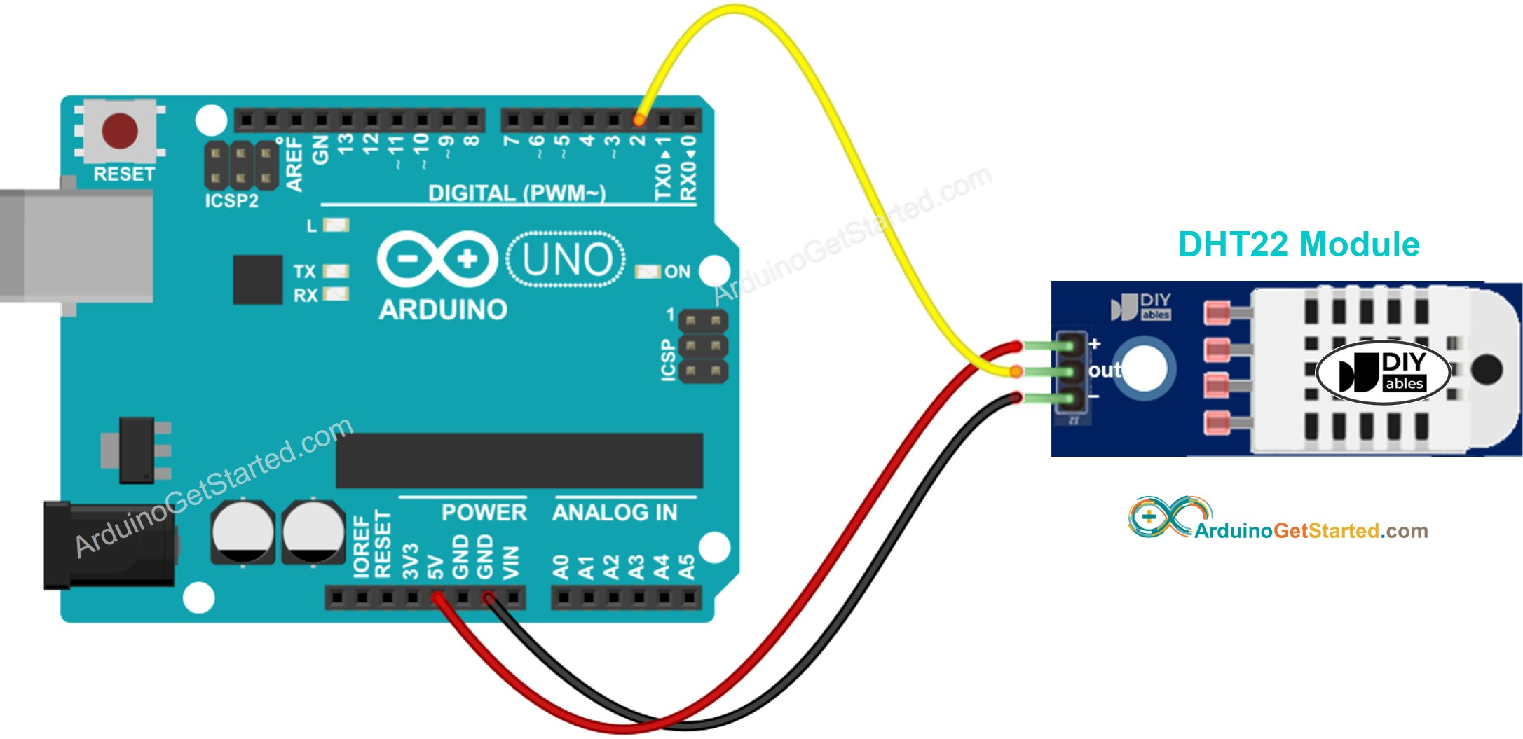
DHT22 Temperature and Humidity Sensor
Asst. Prof. S.Asra
CSE Department, CMRIT

Slide 12
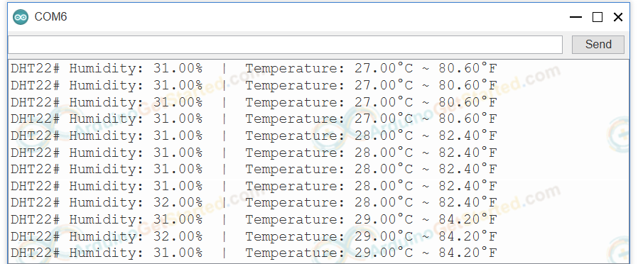
OUTPUT
Asst. Prof. S.Asra
CSE Department, CMRIT

Slide 13
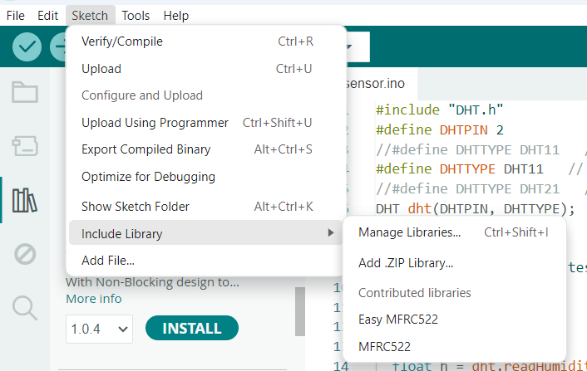
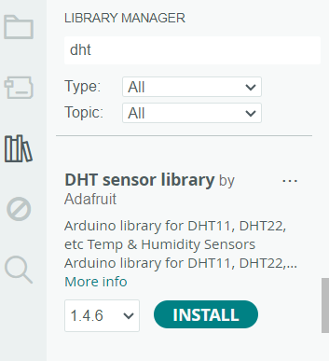
Asst. Prof. S.Asra
CSE Department, CMRIT

Slide 14
Source Code:
#include "DHT.h"
#define DHTPIN 2
//#define DHTTYPE DHT11 // DHT 11
#define DHTTYPE DHT11 // DHT 22 (AM2302), AM2321
//#define DHTTYPE DHT21 // DHT 21 (AM2301)
DHT dht(DHTPIN, DHTTYPE);
void setup() {
Serial.begin(9600);
Serial.println(F("DHTxx test!"));
dht.begin();
}
void loop() {
delay(2000);
float h = dht.readHumidity();
// Read temperature as Celsius (the default)
float t = dht.readTemperature();
// Read temperature as Fahrenheit (isFahrenheit = true)
float f = dht.readTemperature(true);
if (isnan(h) || isnan(t) || isnan(f)) {
Serial.println(F("Failed to read from DHT sensor!"));
return;
}
float hif = dht.computeHeatIndex(f, h);
float hic = dht.computeHeatIndex(t, h, false);
Serial.print(F("Humidity: "));
Serial.print(h);
Serial.print(F("% Temperature: "));
Serial.print(t);
Serial.print(F("°C "));
Serial.print(f);
Serial.print(F("°F Heat index: "));
Serial.print(hic);
Serial.print(F("°C "));
Serial.print(hif);
Serial.println(F("°F"));
}
Asst. Prof. S.Asra
CSE Department, CMRIT

Slide 15

Asst. Prof. S.Asra
CSE Department, CMRIT

